Slide 1
Azure Introduction
Marcelo Silva| marcelo.silva@microsoft.com Senior Application Development Manager

Slide 2
Agenda
Introduction to Cloud
Azure Infrastructure as a Service (IaaS)
DevTest Labs
Azure Platform as a Service (PaaS)
Azure Database Options
Q&A

Slide 3
What is Cloud?
Notes:
Ask the audience: What is Cloud?

Slide 4
Analogy – “Pizza As A Service”
On-Premises
( Private Cloud )
Infrastructure
( as a Service )
Platform
( as a Service )
Software
( as a Service )
Dining Table
Dining Table
You Manage
Dining Table
Dining Table
You Provision & Manage
Drinks
Drinks
Drinks
Drinks
You Provision & Manage
Provisioned & Managed by Vendor
Electric / Gas
Electric / Gas
Provisioned and managed by Vendor
Electric / Gas
Provisioned & Managed by Vendor
Electric / Gas
Oven
Oven
Oven
Oven
Pizza Dough
Pizza Dough
Pizza Dough
Pizza Dough
Sauce
Sauce
Sauce
Sauce
Toppings
Toppings
Toppings
Toppings
Cheese
Cheese
Cheese
Cheese
Home Made
Take & Bake
Delivery
Dining Out

Slide 5
Cloud Computing Capabilities
On-premises
Infrastructure as a Service
Platform as a Service
Software as a Service
Applications
Applications
Applications
Applications
Data
Data
Data
Data
Runtime
Runtime
Runtime
Runtime
Middleware
Middleware
Middleware
Middleware
OS
OS
OS
OS
Virtualizations
Virtualizations
Virtualizations
Virtualizations
Servers
Servers
Servers
Servers
Storage
Storage
Storage
Storage
Networking
Networking
Networking
Networking
Host
Develop
Consume

Slide 6




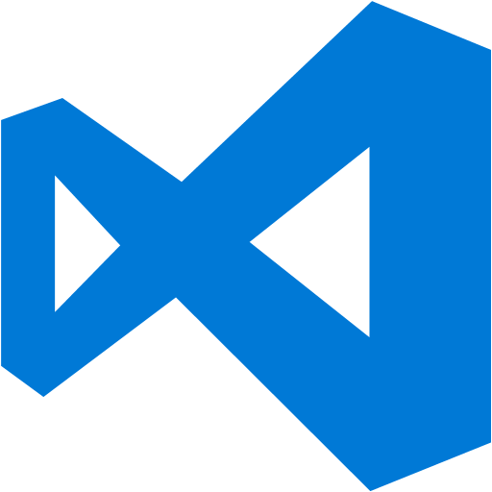


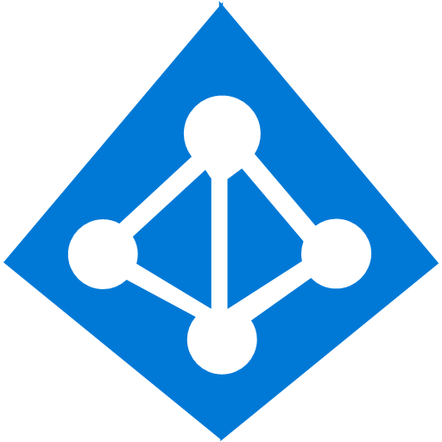








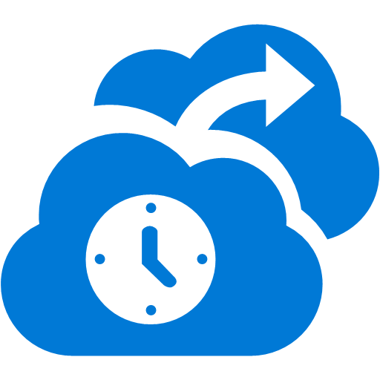

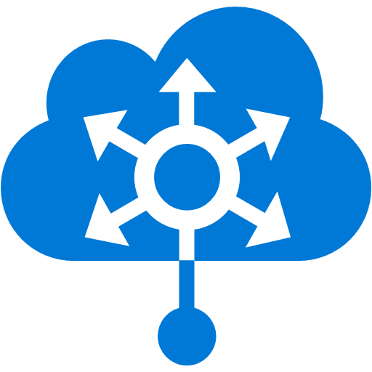







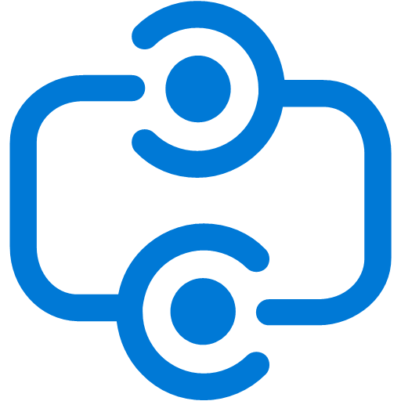







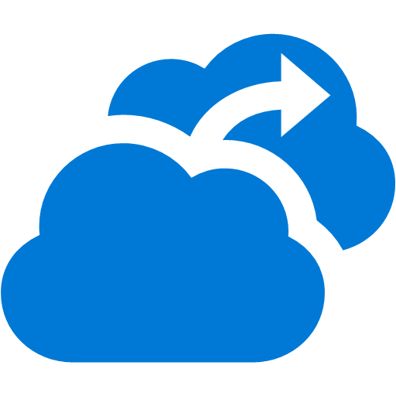

















Platform Services
Security & Management
Compute
Web and Mobile
Developer Services
Hybrid
Operations
Cloud
Services
Service
Fabric
Web Apps
API
Apps
API
Management
Visual Studio
Azure SDK
Portal
Azure AD
Connect Health
Batch
Remote App
Mobile
Apps
Logic
Apps
Notification
Hubs
Team Project
Application
Insights
Active
Directory
AD Privileged
Identity
Management
Multi-Factor
Authentication
Integration
Analytics & IoT
Data
Backup
Storage
Queues
Biztalk
Services
Automation
HDInsight
Machine
Learning
SQL
Database
SQL Data
Warehouse
Operational
Insights
Hybrid
Connections
Service
Bus
Key Vault
Data
Factory
Event
Hubs
Redis
Cache
Search
Import/Export
Store /
Marketplace
Media & CDN
Site
Recovery
Stream
Analytics
Mobile
Engagement
DocumentDB
Tables
VM Image Gallery
& VM Depot
Media
Services
Content Delivery
Network (CDN)
StorSimple
Infrastructure Services
Compute
Storage
Networking
Virtual Machines
Containers
BLOB Storage
Azure Files
Premium Storage
Virtual Network
Load Balancer
DNS
Express
Route
Traffic Manager
VPN Gateway
Application Gateway
Datacenter Infrastructure (36 Regions, 6 coming up soon, 6 US Gov/DoD regions)

Slide 7
Why discuss the cloud?
Public Cloud Platform
$30
Speed
Scale
Economics
$25
$20
Market Share (in Billions)
$15
$10
$5
2008
2009
2010
2011
2012
2013
2014
2015
2016
2017
2018
2019
2020
Notes:
Speed:
Spin up a dev/test environment in minutes from pre-configured images; create databases in seconds
Scale:
Scale the VMs, WebApps, databases, etc manually or automatically; vertically or horizontally
Economics:
Pay for only what you use
No need for “high-mark” compute capacity

Slide 8
A great time to use Azure is when your workloads are…
On and Off
Inactivity
Period
On & off workloads (e.g. batch job)
Over provisioned capacity is wasted
Time to market can be cumbersome
Compute
t
Growing Fast
Compute
Successful services needs to grow/scale
Keeping up w/ growth is big IT challenge
Cannot provision hardware fast enough
t
Unpredictable Bursting
Compute
Unexpected/unplanned peak in demand
Sudden spike impacts performance
Can’t over provision for extreme cases
t
Predictable Bursting
Compute
Services with micro seasonality trends
Peaks due to periodic increased demand
IT complexity and wasted capacity
t

Slide 9
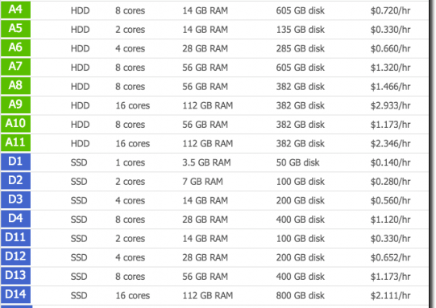
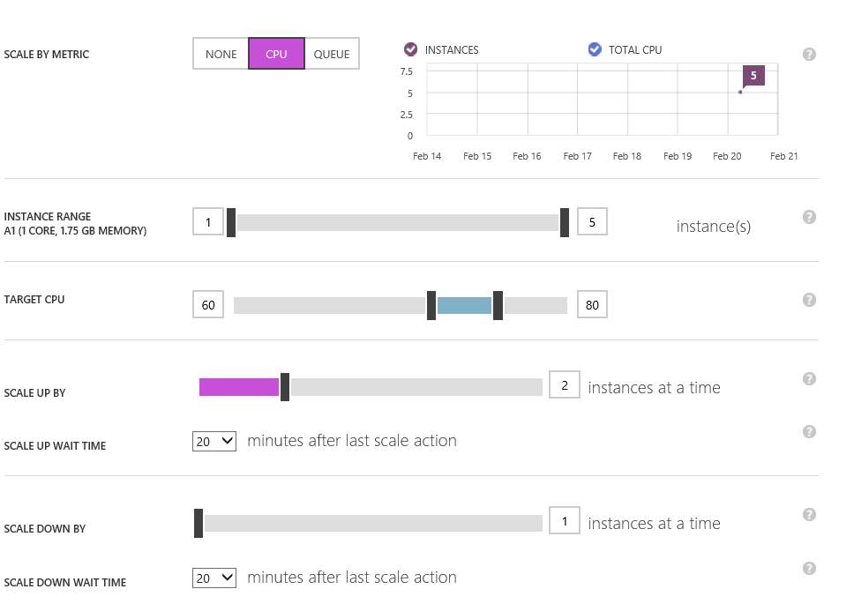
Scale as you need, pay as you go.
Azure’s pay-as-you-go services can quickly scale up or down to match demand, so you only pay for what you use.
Per-minute billing
Competitor price matching for popular infrastructure services
Vertical and horizontal scaling
Auto Scale by pre-defined thresholds (CPU, response time, queue length) or schedules
Vertical Scaling
Horizontal Scaling
Notes:
Licensing sucks!
Vertical scaling is the process of increasing or decreasing the resources of a machine in response to the workload. In Azure this can be accomplished by changing the size of the Virtual Machine. This can help in the following scenarios
If the Virtual Machine is not being used frequently, you can resize it down to a smaller size to reduce your monthly costs
If the Virtual Machine is seeing a peak load, it can be resized to a larger size to increase its capacity
Vertical Scaling Steps
1. Setup Azure Automation to access your Virtual Machines
2. Import the Azure Automation Vertical Scale runbooks into your subscription
3. Add a webhook to your runbook
4. Add an alert to your Virtual Machine

Slide 10
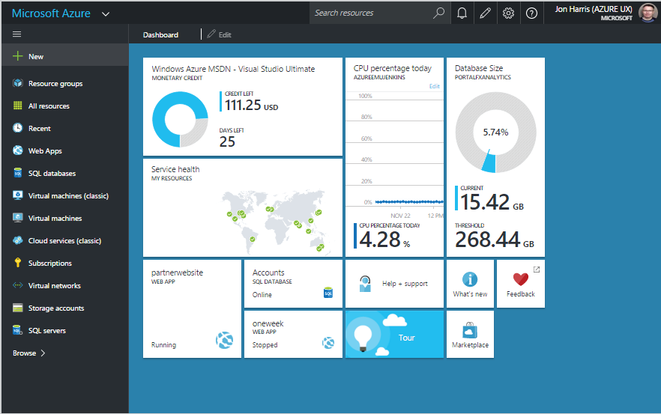

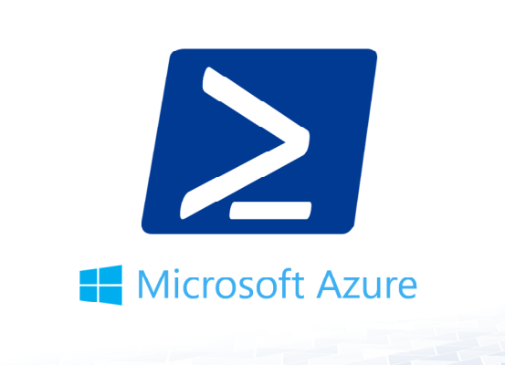
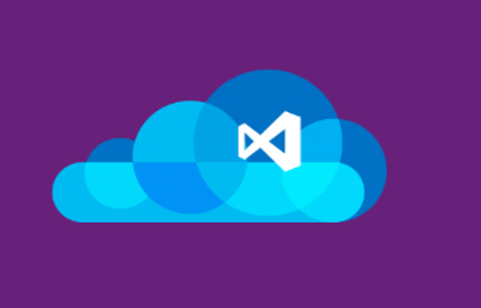
Manage Azure assets your way
Microsoft has made it a priority to give you the control and flexibility to manage cloud assets in multiple ways.
Azure Portal (Management API)
Azure CLI
Azure PowerShell
Visual Studio
Notes:
ARM Templates can be writtin in VS with json nomenclature and stored in source control and processed to create environments. Truly coding/scripting infrastructure!
Existing configurations can be exported to ARM templates.
Template limit 1MB and 64 kb for parameter files.
Talk about UI tools and marketplace for pre-defined templates.

Slide 11
Virtual Machines in Azure

Slide 12
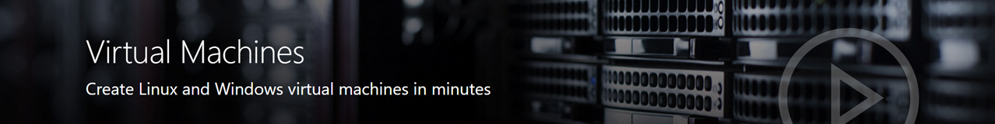
Different sizes for different purposes
General purpose: A0-A7, Av2, D, DS (v2 and v3)
Compute optimized (CPU over RAM): F, Fs
Memory optimized (RAM over CPU): E, ES, M, G, GS
Storage optimized (low latency storage): Ls
GPU optimized (GPU-enabled): NV, NC
High performance compute (CPU/Network intensive, RDMA): H, A8-A11,
Examples:
A0: 1 core/768MB/20GB
DS14v2: 16 cores/112GB/224GB SSD
E64Sv3: 64 cores/432GB/864GB SSD
Notes:
H and N series is RDMA (Remote Direct Memory Access) optimized for parallel computing)
New FPGA chips rolled out across azure datacenters expressly for hyperscale computing – Wikipedia translation 1/10th of a second exa
An even more impressive demonstration involved translating the contents of the English version Wikipedia. The same four FGPA cards would take nearly four hours to translate all 3 billion words of text (about a quarter-mile stack of paper if printed out) into another language. most of the capacity of Azure – about one exa-op worth of compute –applied it to the Wikipedia job, it ran through the entire text in less than a tenth of a second.
Manually upload VHD to Azure from on-premises. No support for VHDX format.

Slide 13
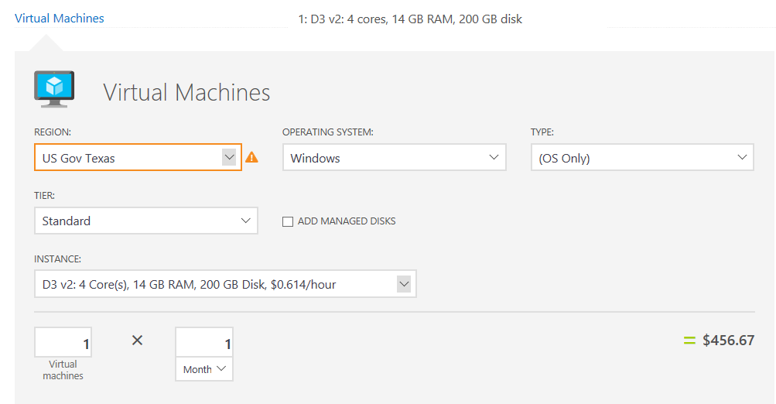
Azure pricing calculator (https://azure.microsoft.com/en-us/pricing/calculator/)
Notes:
H and N series is RDMA (Remote Direct Memory Access) optimized for parallel computing)
New FPGA chips rolled out across azure datacenters expressly for hyperscale computing – Wikipedia translation 1/10th of a second exa
An even more impressive demonstration involved translating the contents of the English version Wikipedia. The same four FGPA cards would take nearly four hours to translate all 3 billion words of text (about a quarter-mile stack of paper if printed out) into another language. most of the capacity of Azure – about one exa-op worth of compute –applied it to the Wikipedia job, it ran through the entire text in less than a tenth of a second.
Manually upload VHD to Azure from on-premises. No support for VHDX format.

Slide 14
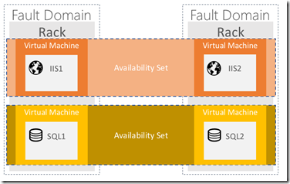
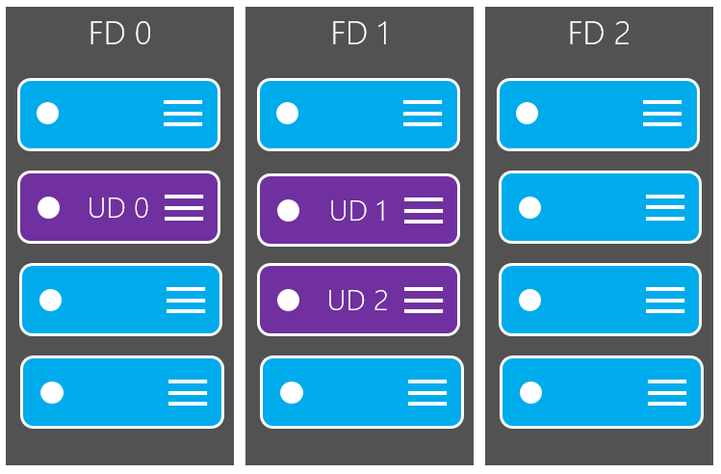
Availability Set:
Fault Domain is a collection of servers that share common resources such as power and network connectivity.
Up to 3 FDs available
Update Domain is a collection of servers that can be rebooted at the same time.
Up to 20 UDs available
99.95% - 99.99% Virtual Machine SLA
Notes:
Sometimes you need to update your app, or Microsoft needs to update the host on which your VM(s) are running. Note that with IaaS VMs, Microsoft does not automatically update your VMs.

Slide 15
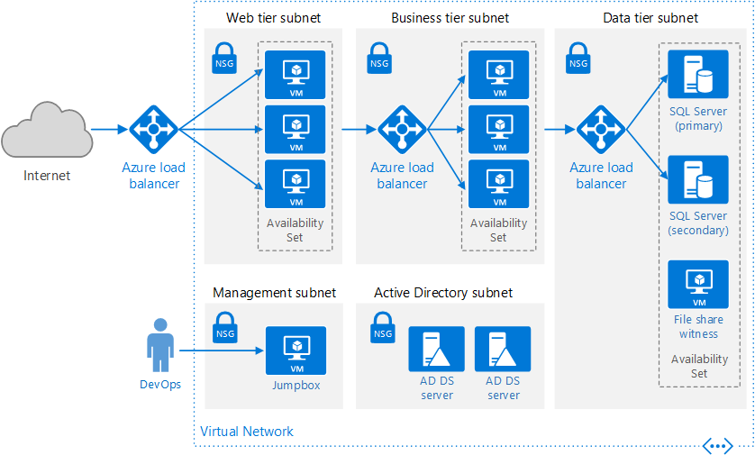
Example:
Public Cloud Platform
$30
$25
$20
Market Share (in Billions)
$15
$10
$5
2008
2009
2010
2011
2012
2013
2014
2015
2016
2017
2018
2019
2020

Slide 16
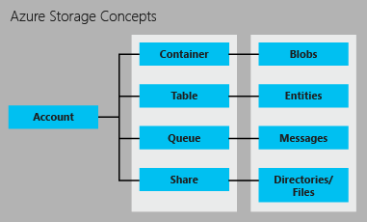
Storage
3 types
Page (harddisk image, vm’s)
Block (video, images)
Append (logging)
LRS, ZRS, GRS
Blob storage stores file data. A blob can be any type of text or binary data, such as a document, media file, or application installer.
Table storage stores structured datasets. Table storage is a NoSQL key-attribute data store, which allows for rapid development and fast access to large quantities of data.
Queue storage provides reliable messaging for workflow processing and for communication between components of cloud services.
File storage offers shared storage for legacy applications using the standard SMB 2.1 protocol. Azure virtual machines and cloud services can share file data across application components via mounted shares, and on-premise applications can access file data in a share via the File service REST AP

Slide 17
Azure Storage
Blobs
“Highly scalable, REST based cloud object store”
Block Blobs: Sequential file I/O
Page Blobs: Random-write pattern data
Tables
“Massive auto-scaling NoSQL store”
Dynamic scaling based on load
Scale to PBs of table data
Fast key/value lookups
Queues
“Reliable messaging at scale for cloud services”
Decouple and scale components
Message visibility timeout and update message to protect against unreliable dequeuers
Disks
“Persistent disks for Azure IaaS VMs”
Built on page blobs
Premium Storage Disks: SSD based, high IOPS, low latency
Files
“Fully Managed File Shares in the Cloud”
Map to file share, standard file system semantics
“Lift and shift” legacy apps
Code against (REST API)
Use on Windows & Linux VMs
Foundational building block of the Azure Cloud –Azure Data Lake, Azure SQL Data Warehouse, Azure HDInsight, OneDrive, Skype, Xbox,…
Hyper Scale: >80 trillion objects, >10 million transactions per second
REST based API, multi-platform, open sourced client libraries for many languages (e.g. Java, Python, Node.js, PHP, Ruby, Android, etc.)
Strong hybrid story with Azure Stack support and integration with StorSimple, Azure Backup and 3rd party storage vendors
Notes:
Azure Blob storage is a service for storing large amounts of unstructured object data, such as text, images, documents that can be accessed from anywhere in the world via HTTP or HTTPS. You can use Blob storage to expose data publicly to the world, or to store application data privately.
Table storage does not support secondary indexes and so any efficient queries should contain the RowKey and the PartitionKey. There can be workarounds such as saving the same data twice in the same table with different RowKeys.
Key-value table storage
Structured or unstructured data
Low latency at Internet scale
Azure Queue storage helps your applications absorb unexpected traffic bursts and can prevent servers from being overwhelmed by a sudden flood of requests. Instead of getting dropped, incoming requests are buffered in the queue until servers catch up—so traffic bursts don’t take down your applications.
With Azure Key Vault, you can encrypt keys and small secrets like passwords using keys stored in hardware security modules (HSMs). For added assurance, you can import or generate keys in HSMs. If you choose to do this, Microsoft will process your keys in FIPS 140-2 Level 2 validated HSMs (hardware and firmware). Key Vault is designed so that Microsoft does not see or extract your keys. Monitor and audit key use with Azure logging—pipe logs into Azure HDInsight or your SIEM for additional analysis and threat detection.
With Key Vault, there's no need to provision, configure, patch, and maintain HSMs and key management software. You can provision new vaults and keys (or import keys from your own HSMs) in minutes and centrally manage keys, secrets, and policies. You maintain control over your keys—simply grant permission for your own and third-party applications to use them as needed. Applications never have direct access to keys. Developers easily manage keys used for Dev/Test and migrate seamlessly to production keys managed by security operations. You can simplify and automate tasks related to SSL/TLS certificates - Key Vault enables you to enroll and automatically renew certificates from supported Public Certificate Authorities.

Slide 18
Azure Storage Platform Capabilities
Scalability
Per account: 500TB of data , 20000 tps, 10Gbps ingress/20Gbps egress
Durability Options
Locally Redundant (LRS), Zone Redundant (ZRS), Geo-Redundant (GRS)
Read access from geo-secondary (RA-GRS)
Availability
99.9% for reads/writes, 99.99% for reads with RA-GRS. Backed by SLA.
Access Control
Symmetric shared key (AuthN)
Shared Access Signatures (SAS) - Delegated AuthZ
Public (blob service only)
Analytics
Rich perf-counter like metrics and detailed logs

Slide 19
Demo
Notes:
Show TFS lab on MS subscription
Show TFS 2017 VM on MS subscription
Create (or show already created) VM running IIS using https://github.com/Azure/azure-quickstart-templates/tree/master/201-web-app-vm-dsc

Slide 20
Dev/Test in Azure

Slide 21
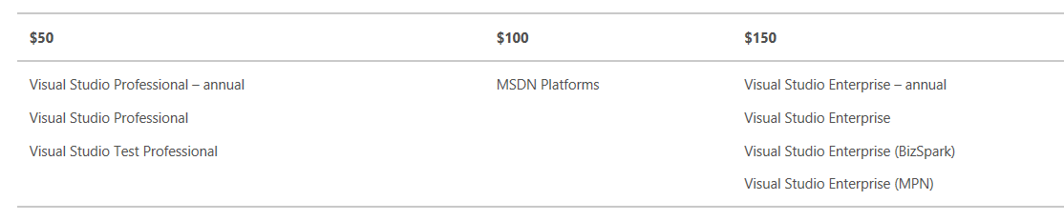
MSDN Subscription Azure Benefits
Your own Azure subscription!
Monthly credit based on subscription type:
Activate today: https://account.azure.com/signup?offer=Azure_MSDN&appId=102&l=en-us&correlationId=b58aeda9-b15d-4ca0-88a7-ea21742902c3

Slide 22
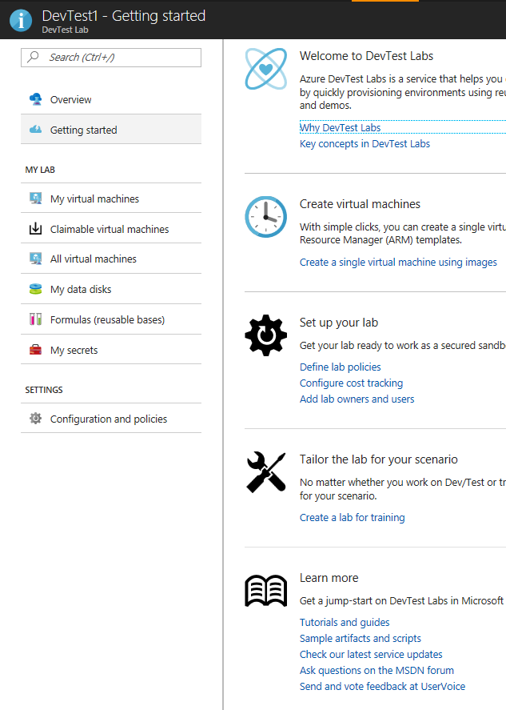
Azure DevTest Labs
Quickly create environments
Re-usable templates
Custom images
Formulas
Minimize waste / control costs
Specify policies
Auto-shutdown rules

Slide 23
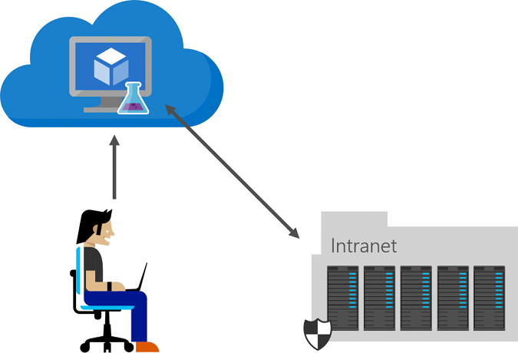
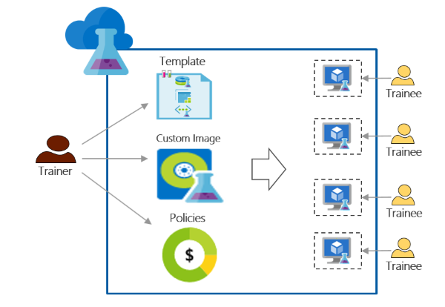
Azure DevTest Labs
Scenarios
Developers
Development machines
Test out the new Visual Studio version
Test the new SQL Server version, etc.
Test environments
Spin up VMs to test applications
Generate load for load testing
Training environments
Trainee only sees VMs assigned to them
VMs identical
Reuse lab over and over

Slide 24
Demo
Notes:
Help enable Azure benefits if needed
Create a devtest lab resource (Note: use MSDN sub with AAD with multiple users)
Admin flow:
White-list images from marketplace
Create formula to have a VM installed with (VS if possible with SQL, or try IIS)
Create a policy to restrict access, max # of VMs
Add developers
Show ARM template to use to create lab from https://github.com/Azure/azure-devtestlab/tree/master/Samples
Optional: explain and rum template and come back later to show deployed lab
Dev flow:
Log in and create the vm from formula and RDP to it

Slide 25
PaaS

Slide 26


Azure Application Platform
Build on a Developer Platform (PaaS)
App Service
Service Fabric
Functions
Cloud Services
Other PaaS
Web, mobile, API, and logic apps
Cloud native, microservices based apps
Serverless, event driven functions
Custom monolithic 3-tier stateless apps
Cloud Foundry, OpenShift, Apprenda, Jetlastic, etc.
Build on the OS (IaaS)
Web and mobile
Microservices
Serverless compute
Existing frameworks
Third-party frameworks
Virtual Machines and Containers
Storage
Networking
Notes:
[The 1,000ft View - PaaS services drill down]
Objective:
Define what constitutes the Azure application platform. What are the main services developers need to think about.
Key talking points:
App Service: is a set of services that has everything you need to build apps that target both web and mobile clients from a single app back end. Supporting a range of language options—.NET, Node.js, Java, PHP, and Python—it consists of Web Apps, Mobile Apps, Logic Apps, and API Apps.
Service Fabric: is a platform that developers and ISVs can use to build and manage custom microservice-based applications at cloud scale and with 24x7 availability. Microservices are an architectural approach based on fine-grained, loosely coupled services that can enable advanced developer agility
Functions: provides serverless, compute for event-driven solutions that extends the existing Azure application platform with capabilities to implement code triggered by events occurring in other Azure services, SaaS products (like Office365 and Salesforce.com), and on-premises systems.
Cloud Services: was the original Microsoft platform as a service (PaaS) service launched in 2010. Inspired by the needs of developers, Cloud Services enabled them to easily deploy .NET applications, taking advantage of cloud infrastructure like Virtual Machines and Virtual Networks without having to manage the low-level details and configuration of Windows Server and the underlying infrastructure.
Other PaaS: all PaaS runs great on Azure! Azure supports the leading third-party PaaS framework providers like Cloud Foundry and OpenShift.

Slide 27

Azure App Service
Web apps
Web apps that scale with your business
Mobile apps
Build mobile apps for any device
Logic apps
Automate business process across SaaS and on-premises
API apps
Easily build and consume APIs in the cloud
Notes:
[

Slide 28
App Service Features & Capabilities
All features and capabilities are shared across all of App Service application (Web, Mobile, and API)
Enterprise grade
Designed for secure mission-critical applications
Fully managed
Optimized for Availability and Automatic scale
Built for DevOps
Agility through Continuous Deployment
Premium Tier
App Service Environments
Hybrid Connections / VPN Support
Scheduled Backup
Azure Active Directory Integration
Site Resiliency, HA, and DR
Web Jobs
Role Base Access Control
Audit / Compliance
Enterprise Migration
Client Certs
Redis Caching
IP Restrictions/ SSL
Web Sockets
SQL, MySQL, DocDB, & Mongo
Automated Deployment AutoScale
Built-in Load Balancing
WW Datacenter Coverage
End Point Monitoring & Alerts
DR Site Support
WildCard Support
Dedicated IP address
HTTP Compression
Premium WordPress
Sticky Sessions
App Service Environment
Remote Debugging w/ Visual Studio
Site Staging Slots
Traffic Routing
Continuous Integration/Deployment
Git, Visual Studio Online and GitHub
App & Site Diagnostics
OS & Framework Patching
Site Extensions Gallery
NET, PHP, Python, Node, Java
Framework Installer
Browser-based editing
Auto-Healing
Logging and Auditing
Admin-Site
Support Site Extension
Notes:
And customers are using some of these features
This is a partial feature list and we are not going to cover each and every feature.
However, I do want to point that we have relapsed 21new public facing features in the past 12 months. at a rate more than 2 features per month….
We plan to continue this pace and even accelerate it to provide more value and innovation to our customers
Hybrid Connections / VPN Support
Scheduled Backup
Azure Active Directory Integration
Site Resiliency, HA, and DR
Web Jobs
Role Base Access Control
Audit / Compliance
Enterprise Migration
Client Certs
Cache
IP Restrictions/ SSL
Web Sockets
SQL, MySQL, DocDB, & Mongo
Sticky Sessions
Authorization/ Authentication
Automated Deployment AutoScale
Built-in Load Balancing
WW Datacenter Coverage
End Point Monitoring & Alerts
App Gallery
DR Site Support
WildCard Support
Dedicated IP address
HTTP Compression
CDN Support for Websites
Premium WordPress
App Services Environments
Remote Debugging with Visual Studio
Site Staging Slots
Testing in Production
Continuous Integration/Deployment
Git, Visual Studio Online and GitHub
App & Site Diagnostics
OS & Framework Patching
Site Extensions Gallery
NET, PHP, Python, Node, Java
Framework Installer
Browser-based editing
Auto-Healing
Logging and Auditing
Admin-Site
Support Site Extension

Slide 29
Web Apps: more than just hosting
Cross platform web application hosting
Simple authentication: Azure AD, Facebook, Google, Twitter, Microsoft Account
Easily scale out and scale up, including auto-scaling
WebJobs for background processing
Configurable Deployment Slots
Full Kudu support
WEB Apps
Web Apps that scale with your business
Notes:
VNET integration: https://docs.microsoft.com/en-us/azure/app-service-web/web-sites-integrate-with-vnet
App Service Environment provides isolation and it can contain app service plans. It can also integrate directly with VNET.
App service plan is a container with compute/memory allocations that can contain web apps.

Slide 30
Mobile Apps: scalable, globally available
Build native and cross platform apps
Connect to your enterprise systems
Build offline-ready apps with data sync
Push Notifications to millions in seconds
Complete set of open-source client SDKs for iOS, Android and Windows development
MOBILE Apps
Build mobile apps for any device

Slide 31
Logic Apps: for easy automation
Design end-to-end in the browser
Usable with custom API apps of your own
Dozens of pre-built templates to get started quickly
Out of box support for popular SaaS and on-premises apps
BizTalk APIs for expert integration scenarios
LOGIC Apps
Automate SaaS and
on-premises systems
Notes:
Automate business processes—fast. The Logic Apps feature of Azure App Service helps keep your marketing and analytics SaaS apps in sync. Extend business processes in minutes. Boost sales productivity by reducing data entry. Model all of these processes and more with an intuitive visual design language and deploy reliable, enterprise-ready workflows in no time. Get started even faster using an Azure App Service template from Azure Marketplace.
Logic Apps can be designed end-to-end in the browser. Start with a trigger - from a simple schedule to whenever a tweet appears about your company. Then orchestrate any number of actions using the rich gallery of connectors.
Usable with custom API apps of your own. Don't see the connector you need? Logic Apps are part of the App Service suite and designed to work with API apps; you can easily create your own API app to use as a connector. Build a new app just for you, or share and monetize in the marketplace.
Dozens of pre-built templates to get started quickly. To help you get started we've provided a gallery of templates that allow you to rapidly create some common solutions. From advanced BizTalk solutions to simple SaaS connectivity, and even a few that are just 'for fun' - the gallery is the fastest way to understand the power of Logic Apps.
Out of box support for popular SaaS and on-premises apps. Logic Apps offers out-of-box connectivity to a vast ecosystem of SaaS and cloud-based applications, including Salesforce, Office 365, Twitter, Dropbox, Google Services, and many more. It's never been easier to access your data and keep your disparate systems up to date, in real-time. New connectors are being added to Marketplace all of the time.
BizTalk APIs for expert integration scenarios. Start easy and grow as you need. Logic Apps can easily leverage the power of BizTalk, Microsoft's industry leading integration solution to enable integration professionals to build the solutions they need.

Slide 32

API Apps: easily use cloud or custom APIs:
Integrated Swagger support for easy consumption
Simple access control with built-in authentication services
Dedicated tools in Visual Studio for API app development
Integration with Logic Apps
No code changes required for existing APIs
Api Apps
Create, consume, and
host APIs more easily
Notes:
API Apps provides the following features available today in public preview:
Easy consumption. Integrated Swagger support makes your APIs more easily consumable by a variety of clients. More easily configure CORS, and automatically generate client code for your APIs in a variety of languages including C#, Java, and JavaScript.
Simple access control. You can help protect an API app from unauthenticated access with no changes to your code. Built-in authentication services help secure APIs for access by other services or by clients representing users. Supported identity providers include Azure Active Directory and third-party providers such as Facebook and Twitter. Clients can use Active Directory Authentication Library (ADAL) or the Mobile Apps SDK. For more information, see Authentication for API apps and mobile apps in Azure App Service.
Dedicated tools in Visual Studio streamline the work of creating, deploying, consuming, debugging, and managing API apps.
Integration with Logic Apps. API apps that you create can be consumed by App Service Logic Apps.
No code changes required for existing APIs. You don't have to change any of the code in your existing APIs to make use of API Apps features -- just deploy your code to an API app. Your API can use any language or framework supported by App Service, including ASP.NET and C#, Java, PHP, Node.js and Python.

Slide 33
Demo
Notes:
Demo TailspinToys app that’s hooked up to VSTS, with slots
Show VSTS code/build/RM setup
Run a build and show release go thru QA, Staging slot and prod slot

Slide 34
API Management

Slide 35








The rise of APIs
“In the age of the customer, every business is a digital business. This means software is central for today’s enterprises, and APIs are central for today’s software.”
”... APIs play on the frontlines of business opportunity, creating new sources of revenue and market presence; they play behind the scenes, unlocking data and transactions buried in back-office systems; and they play anywhere in between.”
“Sizing The Market For API Management Solutions”
Randy Heffner and Michael Yamnitsky
Forrester Research Inc.
April 2, 2015
Notes:
More organizations adopt API-centric business strategies. Importance of APIs and investment in them are rising. APIs need to protected, measured and harnessed. In other words they need API management.

Slide 36

Azure API Management
AZURE API MANAGEMENT
Facade
decouple
modernize
optimize
...
Middleware
secure
protect
cache
...
Monitoring
usage
health
monetization
...
Developer
discover
document
on-board
...
Notes:
First is APIM creates a public facade over your APIs and decouples API implementations or backends from API consumers enabling them to evolve independently. This includes hiding all APIs regardless of their location behind a single domain name and API address. Exposing only a subset of backend capabilities to API consumers. Modernizing and normalizing APIs by changing their URL structure and response formats. Optimizing APIs for specific consumers and scenarios by conditionally stripping down the responses. Dynamically routing requests to implement advanced versioning approaches
Second, APIM allows API implementers to externalize and centralize common cross cutting concerns and focus on the core value, the domain related logic. Security, throttling, cross domain access and response caching are just a few horizontal capabilities you'll get from APIM. APIM supports API key, JWT token validation as well as IP based authorization. We offer a number of cross domain techniques including full support for CORS. APIM implements distributed quota and rate limiting policies that allow a great degree of flexibility and scale. It comes with built in response cache and policies that allow fine grained control over what and how gets cached
Having insight into usage and health of your APIs is important and APIM captures metrics and provides key reports out of the box. For those customers who are looking to monetize their APIs we collect and offer via API data allowing them to implement a variety of subscription business models.
With APIM Developer portal you can treat internal and external developers the same way from the get go and provide them with a self service on-boarding experience, AP catalog, documentation, samples, and allow them to send request to your APIs without writing a line of code.
■ Know who API users are and engage them like customers. Whether the developers programming to one’s APIs are inside the organization or outside, knowing who they are is a foundation of API success. For an API provider that charges for API use, like Twilio and SendGrid, this is of course necessary for collecting revenue, but even for free access, as with New York’s and Chicago’s transit systems’ APIs, knowing API users enables greater understanding of how APIs are used and what direction to take APIs in the future. API users, whether they pay or not, should be engaged as customers.
■ Clarify the rules of API access. For reasons of capacity management and security, access to APIs is rarely unlimited. But customers (i.e., API users in this case) don’t like surprises, so the
rules for access must be clear, such as what data may be accessed and how many requests are allowed per minute or per month. is may include de nition of di erent access plans with di erent rules for di erent API users.
Make it easy to use the API. rough documentation, examples, and discussion forums, it must be easy for API users to understand the API, get answers to questions, test API usage, and migrate between API versions. Although REST services are needed for mobile, other styles of services may also be part of an enterprise API strategy (e.g., SOAP, message queuing).
Enforce the rules of API access. API providers must validate that incoming API requests are authorized and comply with the rules de ned by the access plan each API user is associated with.
Proactively manage API success by treating it as a product. Whether API users are internal, external, or both, to optimize the business value of an API, the API provider must treat it as a product with customers and a life cycle. Whether via basic reporting or advanced analytics, API providers must understand patterns of API access, including error rates that may indicate the
API is di cult to understand. New versions of the API need a smooth and managed rollout to API users.
■ Connect API access to functions and data within their technology estate. APIs deliver their value by connecting to the API provider’s data and applications. Some of these assets may be API- ready, while others may need some manner of integration connectivity to make them accessible.

Slide 37
Azure API Management
API consumers
AZURE API MANAGEMENT
Facade
decouple
modernize
optimize
...
Middleware
secure
protect
cache
...
Monitoring
usage
health
monetization
...
Developer
discover
document
on-board
...
APIs on Azure
Azure APIs
On-prem APIs
3rd party APIs

Slide 38



AZURE API
MANAGEMENT
APP DEVELOPERS
Developer Portal
DIRECT OR
VPN
BACKEND
APIs
APPS
Gateway
Hosted anywhere.
Developed using any technology.
API PUBLISHERS
Publisher portal
Notes:
APIM on Azure is provided as a fully managed cloud service. It has 3 key components.
Publisher portal is used by API publishers, people who own the APIs, to manage the APIs. On the Publisher portal one can add and edit APIs, configure API policies, view analytics, etc. Metadata and settings entered on the Publisher portal drive both the gateway and the developer portal. Management operations can be automated by using a comprehensive but easy to learn and use API.
Developer portal is turn key and shows auto-generated API catalog, interactive documentation and samples. Its look-and-feel and behavior can be customized to reflect customer brand and needs.
Gateway acts as a front door and mediates all the requests to your APIs, collecting usage and health data and applying policies configured via Publisher portal. It can connect to backends located anywhere and implemented and running on any technology stack either directly or via VPN. Gateway supports both Basic HTTP and mutual certificate authentication.

Slide 39
Demo
Notes:
Demo calculator API setup in MSDN azure sub (resource group Exam70533)
Showcase link to Azure AD
Link: https://docs.microsoft.com/en-us/azure/api-management/api-management-howto-protect-backend-with-aad
Show code and swagger API metadata
Show options to apply policy, view metrics, etc.

Slide 40
Microservices Service Fabric Containers

Slide 41
Why a microservices approach?
Build and operate a service at scale
Continually evolving applications
Faster delivery of features and capabilities to respond to customer expectations
Improved resource utilization to reduce costs
Notes:
Read the following overviews
https://azure.microsoft.com/en-us/documentation/articles/service-fabric-overview-microservices/
MSDN Article on Service Fabric https://msdn.microsoft.com/en-us/magazine/mt595752
Watch this video https://channel9.msdn.com/Events/Visual-Studio/Connect-event-2015/911
Gartner Definition of Cloud-Native Applications
This use case includes applications at any scale, which have been written with the strengths and weaknesses of public cloud IaaS in mind. Cloud-native applications assume that resilience must reside in the application and not in the infrastructure (low "compute resilience" weighting), that the application can run well in a variety of underlying infrastructure configurations (low "architecture flexibility" weighting), that the customer's IT organization will attend to security concerns (low "security and compliance" weighting), and that there are only minimal integrations with existing on-premises infrastructure and applications (low "enterprise integration" weighting). Automation, API capabilities and scale-out capabilities are, however, extremely important. Because many such applications have big data aspects, the big data enablement capability also receives a high weighting in this use case

Slide 42


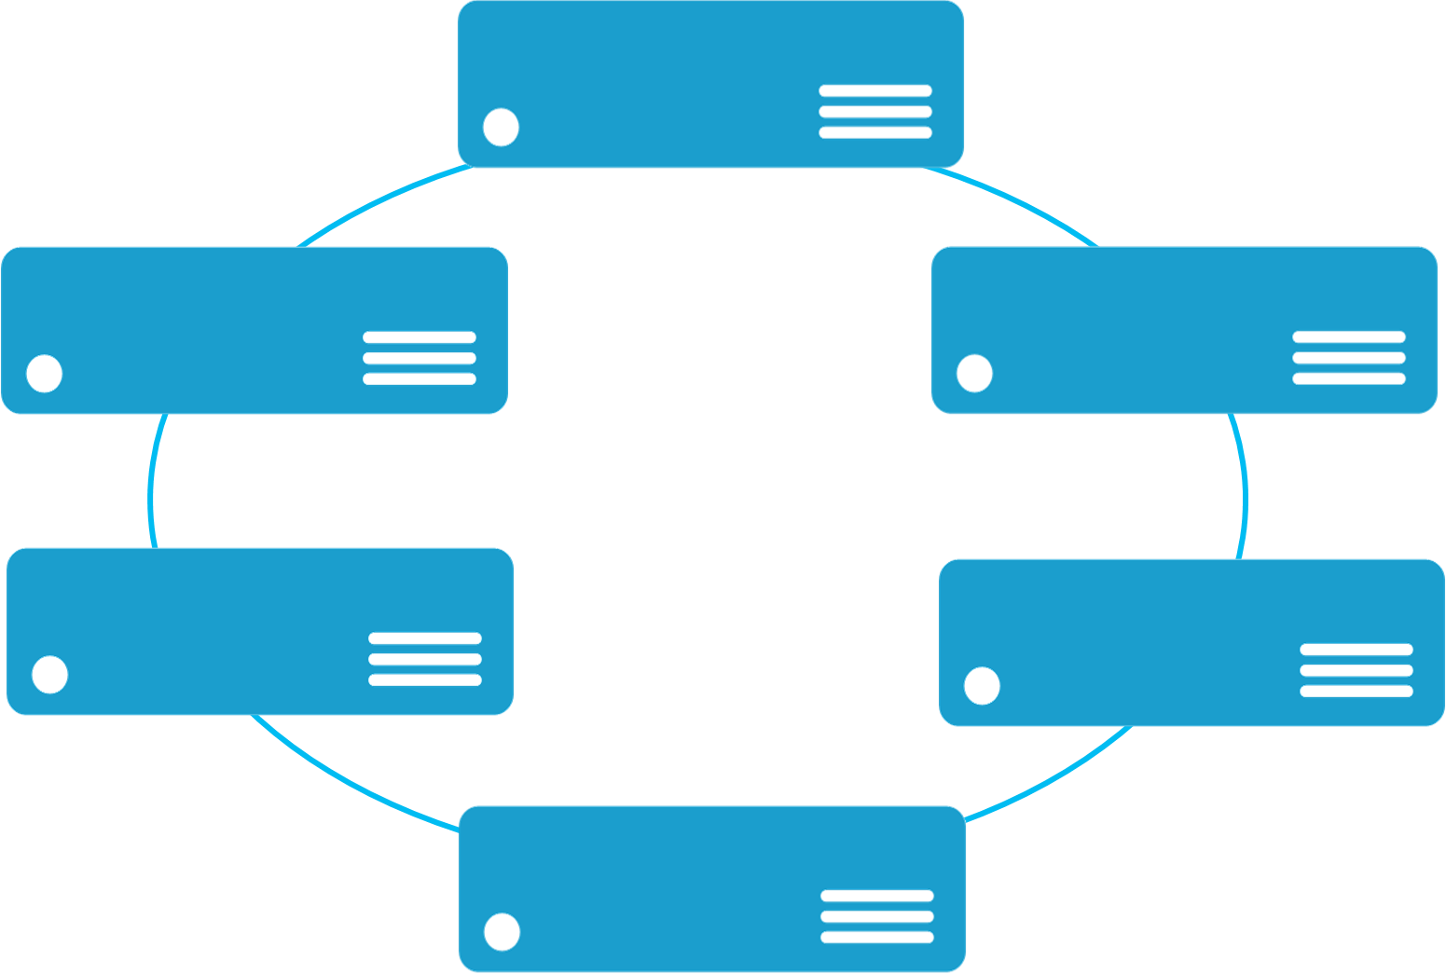


Monolithic application approach
Microservices application approach
A monolith app contains domain specific functionality and is normally divided by functional layers such as web, business and data
App 1
App 1
App 2
A microservice application separates functionality into separate smaller services.
Scales by cloning the app on multiple servers/VMs/Containers
Scales out by deploying each service independently creating instances of these services across servers/VMs/containers

Slide 43
App A
App A’
App B
Containers are isolated, but share OS and, where appropriate, bins/libraries
Bins/Libs
Bins/Libs
Bins/Libs
Bins/Libs
Guest OS
Guest OS
Guest OS
App A
App A’
App B
App B’
App B
App B’
App B
App B’
Bins/Libs
Bins/Libs
Hypervisor
Docker Engine
Host OS
Host OS
Server
Server

Slide 44
Azure Service Fabric (PaaS) A platform for reliable, hyperscale, microservice-based applications
Microservices
High Availability
Data Partitioning
Service Fabric
Health Monitoring
Container Orchestration & lifecycle management
Hybrid Operations
Self-healing
Simple programming models
High Density
Rolling Upgrades
Low Latency
Placement Constraints
Replication & Failover
Stateful services
Fast startup & shutdown
Resource balancing
Hyper-Scale
Automated Rollback
Azure
Private cloud
Other clouds
Notes:
Microsoft Azure has been going through the transition of taking Tier 1 products such as SQL Server, Analysis Server, System center, Lync and running these as cloud services, as well as creating brand new “born in the cloud” Tier 1 services such as DocumentDB. In order to do this, we needed a new kind of PaaS, one that provides all the capabilities shown here such as high availability at scale, running at high density to reduce costs, agility in large development teams to be able to decompose the cloud service down into independent discrete smaller services each of which be partitioned for scale.
Importantly we realized that the largest cost for a cloud service was the day to day management and operation of the service, and not having to worry about the availability of the service in the event of machine, network, process failures. So, Service Fabric also provides a self-healing approach which means you do not need large teams of people to ensure that the service is always running. Equally with the concepts of application versioning, no downtime rolling upgrades and automatic service resource balancing based on current load and health, Service Fabric provides complete lifecycle support for your cloud service.
Service Fabric will be available in Azure as a service and in Windows Server 2016. Applications built against the programming APIs can be deployed to any of these environments with no code changes. Currently, as you would expect given that we developed Service Fabric for our own services, it runs on Windows, but we have started the port on Linux that we will eventually release.
The world is changing for you as developers, as previous on-premise products move the cloud as services to take advantage of utility computing and global reach. You need a platform that helps get you there. Now you can use the same platform that Azure is using for its tier 1 services and all this is installed on your laptop. You have a whole data center in your hands.
*****************************************************************************
Service Fabric is aproven distributed systems platform that:
Makes it easy to build scalable and reliable services
Allows keeping compute and associated state together to achieve high throughput and low latency
Manages full service lifecycle
Can be deployed in-cloud or on-premises

Slide 45
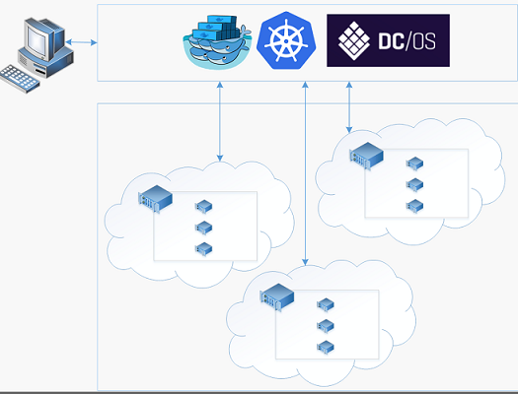
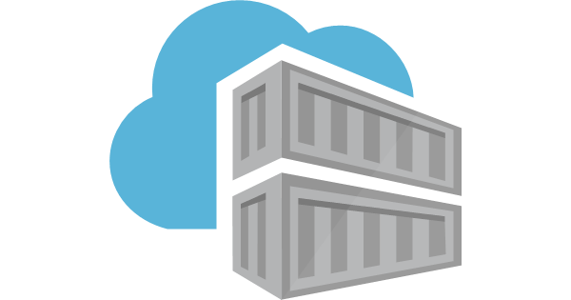
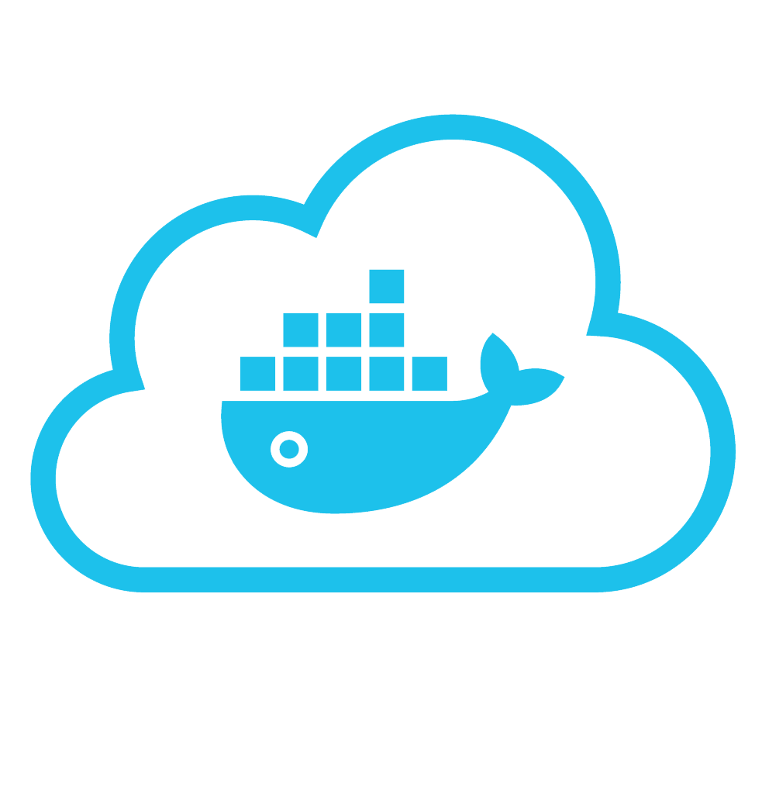
Azure Container Services (IaaS) Create, configure and manage a cluster of VMs to run containers
Azure Container Registry
Docker Registry
Notes:
Microsoft Azure has been going through the transition of taking Tier 1 products such as SQL Server, Analysis Server, System center, Lync and running these as cloud services, as well as creating brand new “born in the cloud” Tier 1 services such as DocumentDB. In order to do this, we needed a new kind of PaaS, one that provides all the capabilities shown here such as high availability at scale, running at high density to reduce costs, agility in large development teams to be able to decompose the cloud service down into independent discrete smaller services each of which be partitioned for scale.
Importantly we realized that the largest cost for a cloud service was the day to day management and operation of the service, and not having to worry about the availability of the service in the event of machine, network, process failures. So, Service Fabric also provides a self-healing approach which means you do not need large teams of people to ensure that the service is always running. Equally with the concepts of application versioning, no downtime rolling upgrades and automatic service resource balancing based on current load and health, Service Fabric provides complete lifecycle support for your cloud service.
Service Fabric will be available in Azure as a service and in Windows Server 2016. Applications built against the programming APIs can be deployed to any of these environments with no code changes. Currently, as you would expect given that we developed Service Fabric for our own services, it runs on Windows, but we have started the port on Linux that we will eventually release.
The world is changing for you as developers, as previous on-premise products move the cloud as services to take advantage of utility computing and global reach. You need a platform that helps get you there. Now you can use the same platform that Azure is using for its tier 1 services and all this is installed on your laptop. You have a whole data center in your hands.
*****************************************************************************
Service Fabric is aproven distributed systems platform that:
Makes it easy to build scalable and reliable services
Allows keeping compute and associated state together to achieve high throughput and low latency
Manages full service lifecycle
Can be deployed in-cloud or on-premises

Slide 46
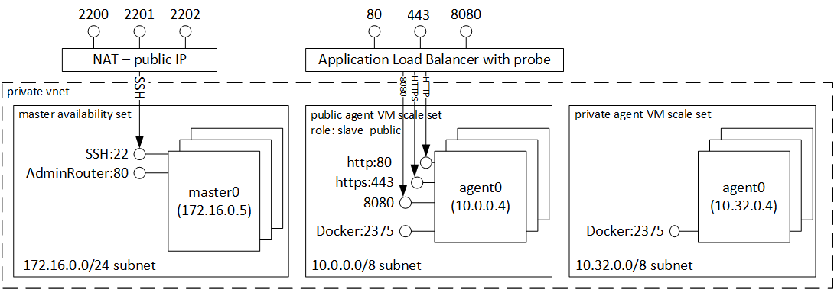
Azure Container Services (IaaS) Create, configure and manage a cluster of VMs to run containers
Azure Container Registry
Docker Registry

Slide 47
Services built with Service Fabric
Skype for Business
Hybrid Ops
Azure Document DB
billions transactions/week
Intune
800k devices
Azure Core Infrastructure
thousands of machines
Event Hubs
20bn events/day
Bing Cortana
500m evals/sec
Azure SQL Database
1.4 million databases
Power BI
IoT Suite

Slide 48
Demo
Notes:
Demo outline: https://docs.microsoft.com/en-us/azure/service-fabric/service-fabric-deploy-existing-app
https://docs.microsoft.com/en-us/virtualization/windowscontainers/quick-start/quick-start-images
Demo code: https://github.com/Azure-Samples/service-fabric-dotnet-getting-started/tree/master/src/GettingStartedApplication/GettingStartedApplication
Demo docker container
- Login to azure container registry: docker login acsdemoregistry.azurecr.io
- Push image to azure registry: https://docs.microsoft.com/en-us/azure/container-registry/container-registry-get-started-docker-cli
1) Docker demo (single container) sequence:
docker build -t marcelos/iis-dockerfile .
docker run -d -p 80:80 marcelos/iis-dockerfile ping -t localhost
docker exec -i epic_carson ipconfig
docker rm -f epic_carson
docker ps
docker login acsdemoregistry.azurecr.io
docker search iis
docker tag marcelos/iis-dockerfile acsdemoregistry.azurecr.io/marcelos/iis-dockerfile
docker push acsdemoregistry.azurecr.io/marcelos/iis-dockerfile
docker rmi marcelos/iis-dockerfile
docker rmi acsdemoregistry.azurecr.io/marcelos/iis-dockerfile
docker images
docker pull acsdemoregistry.azurecr.io/marcelos/iis-dockerfile
2) Docker demo: running a docker container in Azure Service Fabric
Solution:
folder ContainerOnSF,
Repo:
https://marcelos.visualstudio.com/DefaultCollection/DemosGit/_git/DockerDemo
Cmd sequence:
https://docs.microsoft.com/en-us/azure/service-fabric/service-fabric-get-started-containers
N/A - Azure container service demo sequence (Azure CLI 2.0):
https://docs.microsoft.com/en-us/azure/service-fabric/service-fabric-get-started-containers
Repo: https://marcelos.visualstudio.com/DefaultCollection/DemosGit/_git/DockerDemo

Slide 49
Azure Functions

Slide 50








Azure Functions
Serverless
Accelerate development
Bind into services
Azure Service Bus
Azure Event Hub
Azure Storage
</>
Dropbox
Sendgrid
AzureDocDb
Event-driven scale
Reduced Dev Ops
Develop your way
Local development
OneDrive
Box
Twilio

Slide 51
What is “serverless”
Abstraction of servers
Event-driven scale
Sub-second billing
Notes:
Abstraction of servers, infrastructure and configuration of operating system
Event-driven scale
Sub-second billing
Stateless
Serverless compute is a fully managed service. Some refer to it as Functions as a Service
OS and Framework patching is performed for you
There is zero administrative tasks and no need to manage any infrastructure
You just deploy your code (function) and it runs
Your code runs within seconds and for very short period of time
Serverless compute scales quickly (almost instantly) and vastly
Automatically scales within seconds
No scale configuration is required (there is no way to configure scale or limits)
Scales to match any given workload. Scales from zero to handle tens of thousands concurrent functions invocations within seconds
Pay only for the time your code is running
Serverless compute reacts to events
React, in near real-time, to events and triggers
Triggered by virtually any event from Azure service or 3rd party services

Slide 52
How is it different
Mono-lithic application
Inside client app
Complex framework
Loosely coupled components
Outside client app
Micro-functionality
Notes:
Mono-lithic application -> loosely coupled components
Events happening async outside client application
Build/use micro-functionality to react to a single event

Slide 53
Benefits of “serverless”
Ship faster
Reduced dev ops
Focus on business logic
Notes:
“Pinnacle of PaaS compute”
Not just hardware “servers”, but software servers are also managed for you
Focus on business logic, not solving technical problems not core to business
Lower effort to get started makes it easier to experiment (bots, etc.)

Slide 54
Signs that a serverless pattern might be useful for a given scenario
Stateless → Scale
Not worth deploying a traditional backend
Workload is sporadic (very low & high scale)
Dev ops favored versus dedicated ops
Lots of different services involved that need “glue”

Slide 55
Applications
Example: Timer based processing
Eve
r
y 15 minutes
Find and clean invalid data
Clean table

Slide 56
Applications
Example: Azure service event processing
CSV
File added to
T
ransfo
r
m CSV to data
r
ows
P
ower BI
Blob Storage
Cha
r
t graphic

Slide 57
Applications
Example: Serverless Web Applications architectures
Loaded web page
C
r
eate ad based on user p
r
o
file
Completed page
calls
W
ebHook

Slide 58
Async background processing
Example: Serverless Mobile back ends
Photo taken and
Sto
r
es in blob storage
P
r
oduces scaled images
W
ebHook called

Slide 59
Applications
Example: Real-time stream processing
Millions
o
f devices feed
T
ransfo
r
m to structu
r
ed data
Sto
r
e data in
into St
r
eam Analytics
SQL Online

Slide 60
Applications
Example: Real-time bot messaging
...
?
Message sent
Co
r
tana Analytics answe
r
s questions
Chatbot sends
to Chatbot
r
esponse

Slide 61
Demo
Notes:
Functions: https://azure.microsoft.com/en-us/resources/samples/functions-dotnet-codercards/
Logic apps: use the social scenario below for #tailspintoys: https://docs.microsoft.com/en-us/azure/logic-apps/logic-apps-scenario-social-serverless
Ask the audience to tweet great things about #tailspintoys and check the sentiment on the email generated.
Logic Apps and functions:
RG: LogicAppsDemoRG on MS sub

Slide 62
Container Services X Service Fabric X Functions
Which one to choose?
Azure Container Services
Azure Service Fabric
Azure Functions
Targeting Linux, ok with DC/OS, Swarm or Kubernetes
Open technology, great community support
IaaS: Developers manage underlying infrastructure
Targeting Windows (Linux support is coming)
Rolling/partial upgrades
Run on-prem or any cloud (Azure, AWS)
Full blown programming model (framework)
PaaS: Developers manage the cluster configuration, not individual VM nodes.
Micro-granularity (single functions X service with a couple of functions)
Great for trigger-based services (HTTP, Timer, Webhooks, etc)
Great for long-running processes
PaaS: Developers only care about the code. Let Azure scale and manage underlying infrastructure

Slide 63
But wait! There’s more!

Slide 64
Flow X Logic Apps X Functions
Which one to choose?
Microsoft Flow
Azure Logic Apps
Azure Functions
Office workers, business users
Self-service apps
In-browser and mobile app design tools
Ad-hoc, develop in production
Low customization
IT pros, developers
Mission-critical apps
In-browser and Visual Studio design tools
Full DevOps support
Better customization
Developers
Mission-critical apps
In-browser and Visual Studio design tools
C#, F#, Javascript, PHP, Python, Powershell, Bash
Highly customizable

Slide 65
Azure Database Options

Slide 66

Microsoft Azure: SQL on Azure (VM and PaaS)

Slide 67
Sql Server in the Cloud: Choices…
SQL Server in a virtual machine
Azure SQL Db
Best for…
Lift and shift on-prem applications
Applications need elastic scale and/or reduced infrastructure management overhead
Resources
Customer’s IT group has adequate resources and bandwidth to support and maintain
Customer does not want to add additional IT resources for support and maintenance
TCO benefits
Reduce CAPEX (Capital Expenditure)
Avoiding CAPEX and OPEX (operational expense)
Scalability
Scale up to 20,000 IOPS
Scale out to thousands of databases,
process terabytes of OLTP data
Notes:
Reference: http://azure.microsoft.com/en-us/documentation/articles/data-management-azure-sql-database-and-sql-server-iaas/
Speaker Notes:
With the introduction of the next generation of the Azure SQL Database service, the feature compatibility gap is largely reduced, so parity with SQL Server is no longer the major differentiator between VM and the database service. The big criteria for choosing VM vs. the database service, are costs, time to market, and the type of application(s) using the data tier. For example, Azure SQL Database service is more suitable for Software-as-a- service applications.

Slide 68

SQL Database Service @ 5,000 Feet
A relational database as a service, fully managed by Microsoft
Where near-zero administration and enterprise-grade capabilities are key
Have a database in minutes…
Get capacity on-demand…
Patching, backups, labor-intensive admin features done for you…
Elastic Scale and performance
Business continuity and data protection
Familiar and self-managed
Predictable performance levels
Programmatic scale-out
Dashboard views of database metrics
Self-service restore
Disaster recovery
Compliance-enabled
Familiar & compatible
Programmatic
Self-managed

Slide 69
Microsoft Azure: CosmosDB

Slide 70

Put your data where your users are
Notes:
Imagine a horizontally scalable database that puts data everywhere your users are.
It seems intuitive, but most databases are still light years away from true turn-key global distribution.
Cosmos DB:
Deeply Exploits Cloud Core Properties and Economies of Scale
Fully-managed and Secure
Global Distribution from the Ground Up
Scale-out Architecture

Slide 71
Developing planet-scale apps comes with planet-scale challenges
Write accurate, globally distributed apps
Managing and versioning complex schemas
Scaling both throughput and storage based on global demand
Balancing the needs for strong and eventual consistency
Delivering highly-responsive experiences
Ensuring an always-on system
Notes:
Azure Cosmos DB vision is to be the database for all planet-scale applications and scenarios.
The picture I want you to take away is this.
Build planet-scale databases without worry.
Model the data the way your application needs it to be.
Use the API, tools and framework that you are familiar with.

Slide 72
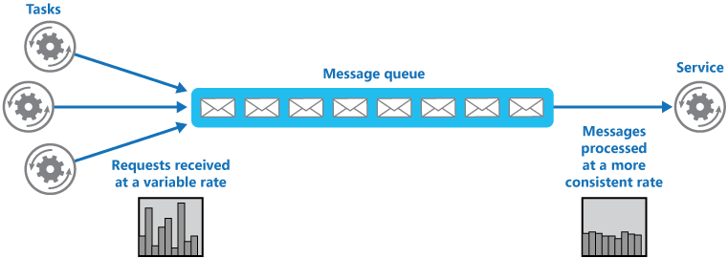
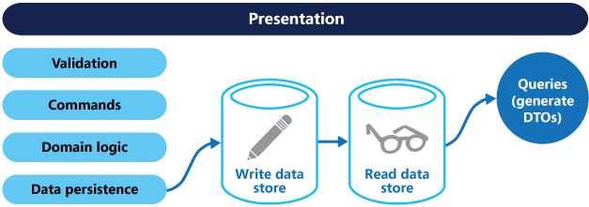
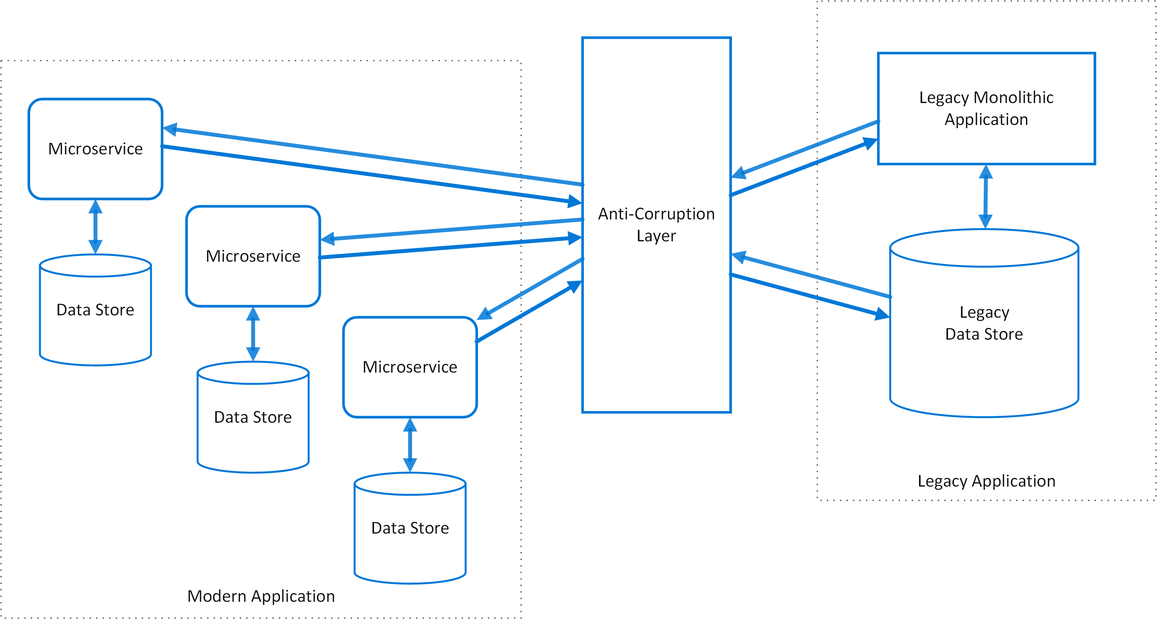
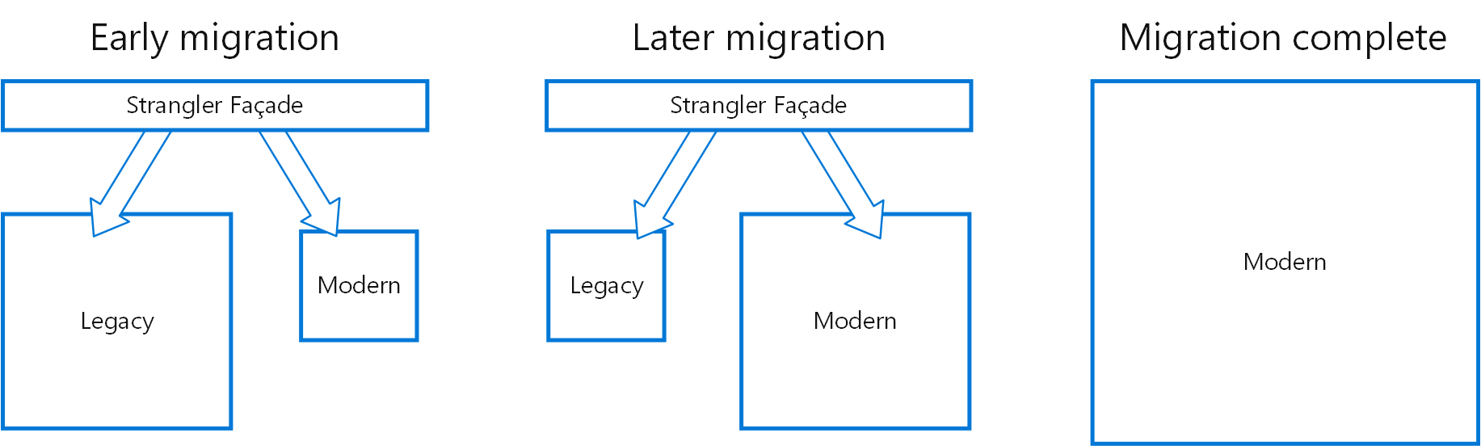
Think differently

Slide 73
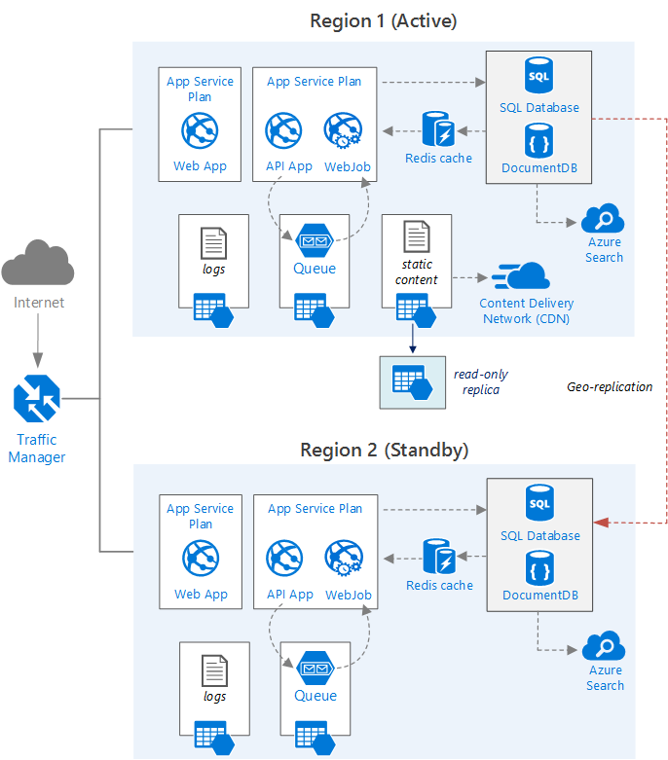
Think differently

Slide 74
Platform Services
Security & Management
Compute
Web and Mobile
Developer Services
Hybrid
Operations
Cloud
Services
Service
Fabric
Web Apps
API
Apps
API
Management
Visual Studio
Azure SDK
Portal
Azure AD
Connect Health
Batch
Remote App
Mobile
Apps
Logic
Apps
Notification
Hubs
Team Project
Application
Insights
Active
Directory
AD Privileged
Identity
Management
Multi-Factor
Authentication
Integration
Analytics & IoT
Data
Backup
Storage
Queues
Biztalk
Services
Automation
HDInsight
Machine
Learning
SQL
Database
SQL Data
Warehouse
Operational
Insights
Hybrid
Connections
Service
Bus
Key Vault
Data
Factory
Event
Hubs
Redis
Cache
Search
Import/Export
Store /
Marketplace
Media & CDN
Site
Recovery
Stream
Analytics
Mobile
Engagement
DocumentDB
Tables
VM Image Gallery
& VM Depot
Media
Services
Content Delivery
Network (CDN)
StorSimple
Infrastructure Services
Compute
Storage
Networking
Virtual Machines
Containers
BLOB Storage
Azure Files
Premium Storage
Virtual Network
Load Balancer
DNS
Express
Route
Traffic Manager
VPN Gateway
Application Gateway
Datacenter Infrastructure (36 Regions, 6 coming up soon, 6 US Gov/DoD regions)

